Slide 1
Patterns of Effective Test Setup
@spetryjohnson
seth@petry-johnson.com

Slide 2
Notes:
You are doing things in your tests that are costing you time, money and frustration.
Suck up your TIME when too hard to READ or UNDERSTAND
Suck up your MONEY, or your company’s money, when they break for stupid reasons
Cause you frustration when it’s harder than it should be to WRITE NEW tests
Those are my assertions, based on years of experience writing tests in the trenches just like you.
Gritted my teeth while spending more time setting up a test than it took to implement the feature.
I have overwhelmed by confusion while trying to understand a test with three screens of setup logic.
And more times than I’d like to admit, I have skipped writing a valuable test because it would have been too costly to write.
That sucks!

Slide 3
That’s OK. I can help!
Notes:
I don’t know about you, but
I don’t like gritting my teeth when writing tests
I don’t like feeling confused when reading our code
And I don’t like feeling ashamed when I let my team down skipping the tests that will help them maintain my code in the future
Because I don’t like those things, and because I think testing is too important to give up on, I have spent a great deal of effort finding better ways to write tests.
In this session I’m going to lead you out of the darkness and into the land of milk, honey and unicorns where tests are easy to write, easy to read, and easy to maintain.
Show you the things that you’re doing that are so costly
Practical things that you can do today to reduce those costs

Slide 4
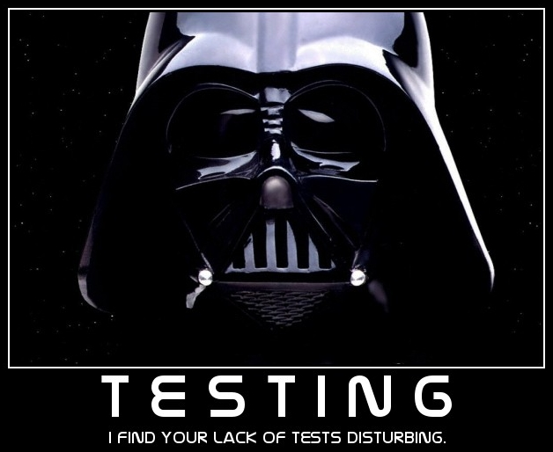
Notes:
Let’s begin our journey with a short story that you might find familiar.
This story begins 6.5 years ago when I had just joined my current employer. We were in the middle of our agile transformation and everyone was super excited about having “user stories” instead of “requirements” and “story points” instead of “estimates”. In the midst of all that agile euphoria, we decided to require tests for 70% of the code in the new project we were starting.
We made this decision because many team members were inexperienced test writers and we wanted to give them some guidance on how much testing was “enough”. I don’t remember why we picked 70% exactly, but the general idea was that 100% coverage seemed unreasonable and that we thought it was a good starting point to have this soft, comforting safety blanket wrapped around the most important 70% of our code.
The project starts out great, everyone starts writing tests and shipping features and things are going pretty good. But a few months later, after the code had started to get a little complex and we’d started revisiting features to add new functionality, I began to realize that something was wrong with our tests. They weren’t really delivering the value that we were expecting.
The first problem I noticed is that despite our 70% test coverage requirement, many important tests were missing. It turns out that as the code got more and more complex, it got harder and harder to set up new tests. So rather than testing the most important 70% of the code, developers ended up testing the 70% that was easiest to test. And as you can imagine, that left a lot of important code uncovered by that safety blanket we were expecting.
The second problem was that the tests that did get written were a nightmare. In one case I needed to make a minor adjustment to a feature. Before writing any new code, however, I wanted to learn more about how the feature currently worked and I wanted to write a failing test. So I opened up the file containing the tests and my heart sank when I saw this:

Slide 5
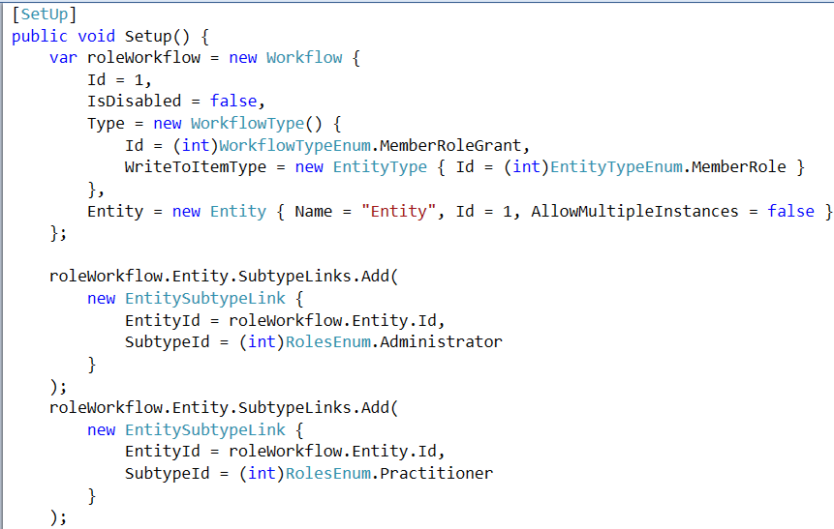
Behold, the reason we’re here

Slide 6
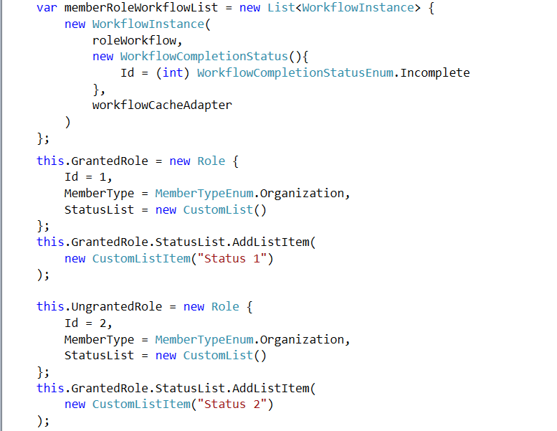
Notes:
... And this …

Slide 7
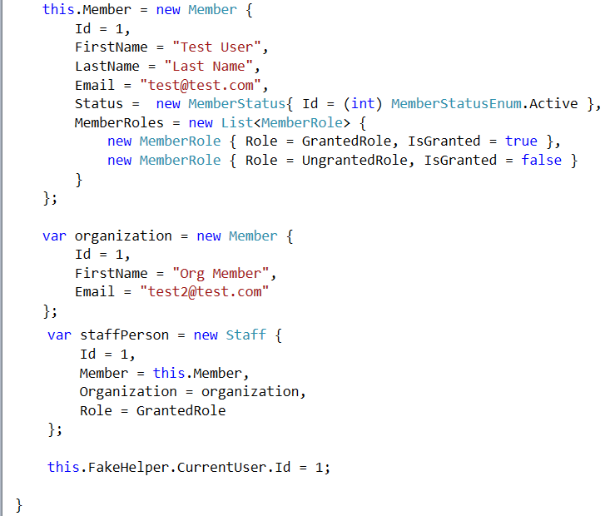
Notes:
… and this.

Slide 8
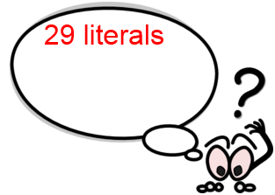
Notes:
This is just the shared setup code for those tests and it contains 29 string, integer and Boolean values being initialized….

Slide 9
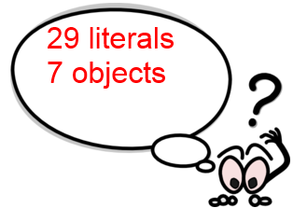
Notes:
… 7 objects being created…

Slide 10
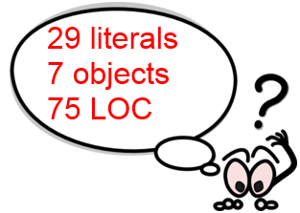
Notes:
… and 75 lines of code to understand.

Slide 11
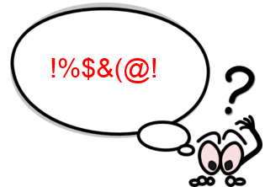
Notes:
Again, This is just the SHARED setup code for the test suite. Individual tests had more code like this, and all depended on different portions of this mess.
Not an isolated case – we had lots of tests like this, and I’m guessing that many of you do to
TRANSITION: This sucks. Sucks to write this, sucks to read it, sucks to pay for it. Fortunately, it doesn’t have to be this way.
The things I’m going to show you today are the techniques that we developed on that original team and have evolved since then to make our tests as easy to write and maintain as possible.

Slide 12
What’s on the agenda?
Identify painful test setup anti-patterns
Basic patterns to follow instead
Advanced techniques for maximal awesomeness
Notes:
Goals today:
Help you understand how costly poor setup code can be.
Show you some basic patterns for reducing those costs
Share some advanced tips and tricks that make a really big difference
NOT going to talk about mocking/stubbing –

Slide 13
What does “setup” mean, exactly?
Anything done prior to running the code being tested
Notes:
Before we go any further, let’s define a few terms and talk about what “setup” means.
For the purposes of this talk
Referring to anything you do prior to running the code being tested.
Might be creating objects in memory
Might be creating data in a database,
Might be putting files on disk.
Might be doing this in some sort of shared setup code that impacts multiple tests, or you might be doing this in a single test method.
In this talk I don’t differentiate. It’s all “setup code”.

Slide 14


What “doing it wrong” looks like
Notes:
First step in recovery is admitting you have a problem! We can’t write good setup code until we are consciously aware of what bad setup code looks like.
TRANSITION: Let’s look at some SPECIFIC ways that poor setup code makes tests difficult to write or maintain

Slide 15
What “doing it wrong” looks like
Complex setup logic
Notes:
First, complex code begets complex setup.
More complicated app ➔ bigger objects ➔ deeper graph ➔ more code
Code == liability
More code ➔ higher cost
Takes more time to write, more time to read and understand
Setup logic should be easy to follow

Slide 16
What “doing it wrong” looks like
Complex setup logic
Creating too many objects
Notes:
Second thing that you want to watch out for is when you are forced to create more objects than your test cares about.
Tests often only care about a PORTION of an object’s data
Order’s SHIPPING STATUS may not care about line items
Customer’s ADDRESS may not care about their name
Not always possible to create objects and specify ONLY what you care about
Constructor
Being forced to create objects that don’t impact the test outcome makes tests hard to write and hard to understand

Slide 17
What “doing it wrong” looks like
Complex setup logic
Creating too many objects
Specifying data that don’t impact the test’s outcome
Notes:
Similar to point #2, poor setup code often suffers from “noise” values that obscure the data that actually impact the test outcome.
Imagine code that fails if the Customer email address is null
When creating a customer in test, we give it a non-null email
The string literal containing the email address, which DOES NOT impact the test outcome, is hard to distinguish from other values that DO impact the test
Other programmers work harder to determine which values are part of the true test context
In order for tests to serve as useful documentation:
Have to clearly communicate the conditions under which their assertions hold true
Specifying values in your test that don’t impact the test makes it much harder for other programmers to read and maintain that test

Slide 18
What “doing it wrong” looks like
Complex setup logic
Creating too many objects
Specifying data that don’t impact the test’s outcome
Duplicated setup logic -OR- painful reuse patterns
Notes:
Finally, poor setup code is often full of duplication, OR it is full of awkwardly reused logic.
When logic is duplicated your tests are less resilient to change and it’s harder to find related tests.
When logic is incorrectly reused, such as through inheritance, it’s harder to maintain.
Transition: Let’s look at what these anti-patterns look like in code

Slide 19
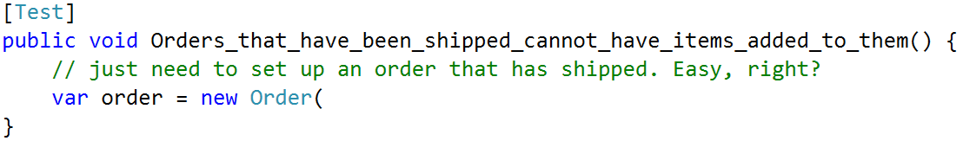
What “doing it wrong” looks like
Notes:
Here’s an example of what these costs look like in code.
In this test, all I need is a shipped Order.

Slide 20
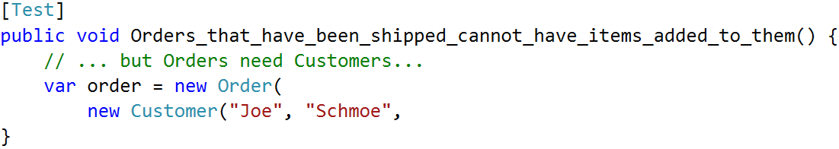
What “doing it wrong” looks like
Notes:
But apparently an Order object needs a Customer…

Slide 21
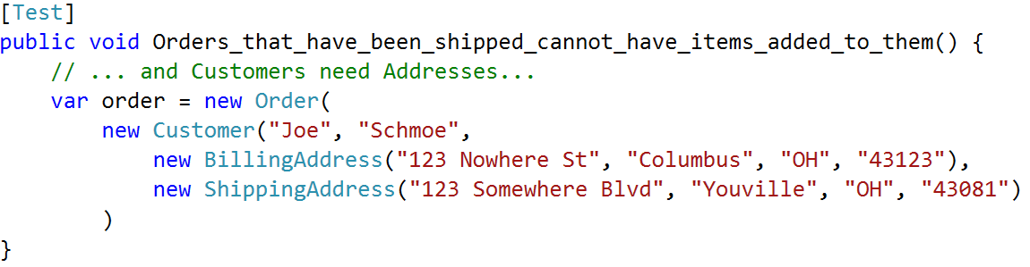
What “doing it wrong” looks like
Notes:
… and a Customer needs some Addresses…

Slide 22
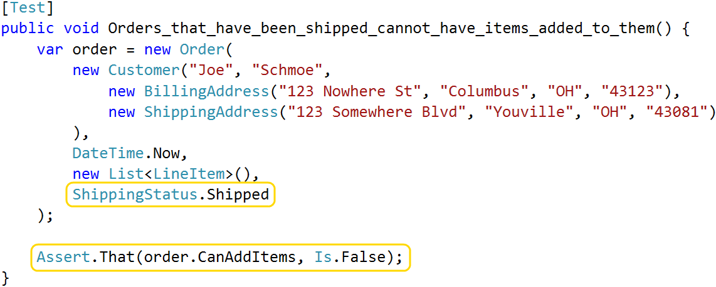
What “doing it wrong” looks like
Notes:
… and by the time I’ve satisfied the constructor, I’ve written a whole lot of code when I really only care about two things: the order’s shipping status, and whether or not it accepts new items.

Slide 23
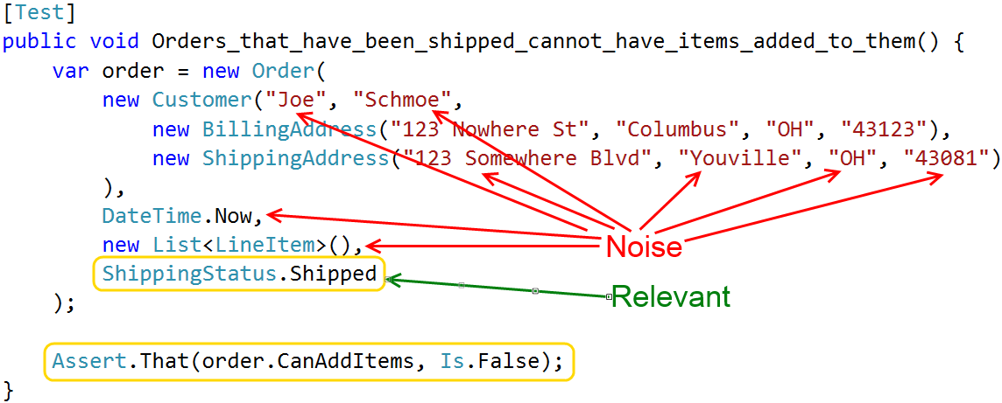
What “doing it wrong” looks like
Notes:
All the things I created, but don’t care about, are noise
Every time you read this – filter signal through noise
Some objects I deal with have 4, 5 or even 6 layers of composition
Object A uses B, B uses C, etc
Being forced to write unnecessary code like this can make it very difficult to set up tests for complex systems
TRANSITION: Noise values aren’t just distracting – also liabilities and make tests brittle

Slide 24
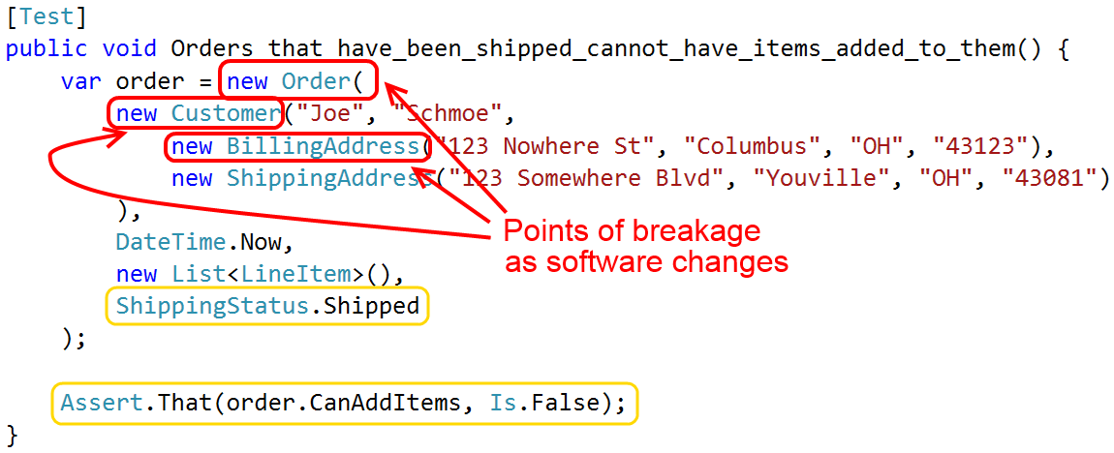
What “doing it wrong” looks like
Notes:
What happens when the Order, Customer or Address constructors get modified?
If you’ve ever made a simple change to your application, and then spent the next two hours cleaning up failing tests, you’ve felt this pain.

Slide 25
Hidden costs of poor setup
Hard to write ➔ aren’t written
Hard to understand ➔ little value
Fragile ➔ drain on velocity
Notes:
To summarize, poor setup code makes test hard to write and maintain.
CLICK: If tests are hard to write, we don’t write them
CLICK: If tests are hard to understand, we get less value from our investment
CLICK: And tests that are brittle require a lot of time to keep running. This takes our focus away from more valuable tasks.

Slide 26

Hidden costs of poor setup
Notes:
Tests that break and are hard to change or understand have a tendency to get “fixed” with the delete key.
Has anyone here ever done that? A test starts failing, you look at it, you run out of fingers to count up the WTFs in the setup logic. So you look over your shoulder, make sure no one is watching, then you delete the test, commit the change, and sneak out to an early lunch.
That sucks! Someone wrote that test because they thought it was valuable, but the cost outweighed the benefit. That’s what we’re trying to avoid.

Slide 27
Ain’t nobody got time for all that!
Notes:
So how do we write tests that don’t suck up all our time, money and energy?
Start by identifying 4 core principles of good setup code, and then we’ll look at specific patterns for adhering to them.

Slide 28
Good setup code is highly expressive
Notes:
The first principle is that tests should be “highly expressive”. What does that mean?
Dictionary defines “expressive” as “effectively conveying thought or meaning”.
Means that other developers should be able to read and understand our setup code with as minimal effort as possible
TRANSITION: This is a really important idea so we’re going to dig in and look at a bunch of ways to write expressive code.

Slide 29
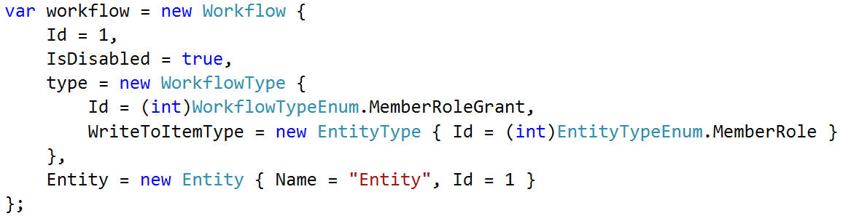
Good setup code is highly expressive
High “signal-to-noise” ratio
Notes:
One aspect of expressive code is that it has a high signal-to-noise ratio.
All unnecessary code
What’s left is as easy read and scan as possible.
We read tests every day;
Can’t understand the assertions unless we understand the context too
Make it as effortless as possible for someone to digest your setup code
CLICK: Here’s an example. Quick, what’s the point of this code? It’s hard to tell because there’s so much going on. And it turns out that a lot of what is going is noise.

Slide 30
Good setup code is highly expressive
High “signal-to-noise” ratio
Notes:
How about this?
Does same thing - removed all the extraneous noise and all that you’re left with is a simple, concise expression of my intent
This is the sort of readability I’m talking about

Slide 31
Good setup code is highly expressive
Easy to compare similar code
Notes:
It’s also important that we can quickly compare similar tests and see how they differ.
As software gets complex and you add more rules, you end up with a lot of similar tests that differ in subtle, but important, ways.
It is much easier to understand and maintain those tests when you can quickly and visually compare them to see what’s different.

Slide 32
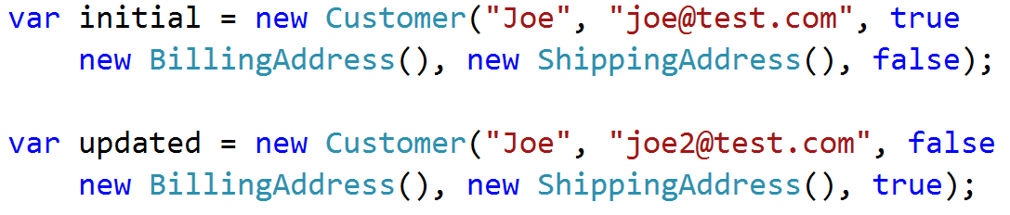
Good setup code is highly expressive
Easy to compare similar code
Notes:
How quickly does your eye spot the difference between these two statements?
(pause)

Slide 33
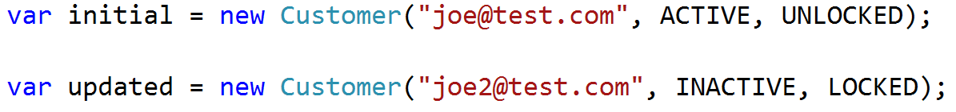
Good setup code is highly expressive
Easy to compare similar code
Notes:
How about now?
Expressive code is easier to scan and compare.
As you write more tests, or as your tests get more complex, this can make a huge difference

Slide 34
Good setup code is highly expressive
Tests should use no more than 1 screen of code
Notes:
Another way to force yourself to write more expressive setup code is to limit yourself to a single screen of code per test
General rule of thumb,
Purpose of this constraint - hyper-focused on the clarity of my setup code.
If can’t describe the test data in just a few statements - writing that code at too low a level.
This is not a hard and fast rule, but I’ll show you some techniques in a few minutes that help me meet this goal the majority of the time.

Slide 35
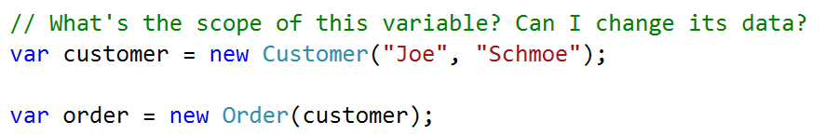
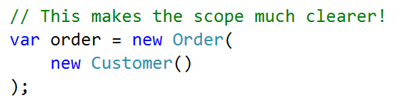
Good setup code is highly expressive
Avoid intermediate objects
Notes:
Another way to fit a test onto a single screen is to write more concise code, and one way to do that is to avoid what I call “intermediate setup objects”.
Sometimes need to create one object only to create something else – never refer to the first object again
Example: need a Customer to create an Order
Two statements, one meaningful operation [create the Order]
Not immediately clear if the Customer is reused elsewhere. Is it safe to change?
Is the customer data part of the core essence of the test? Or is it noise?
CLICK: 2nd image:
Moving instantiation of Customer inside the Order constructor - express 1 meaningful operation as 1 code statement.
Avoiding intermediate objects improves clarity

Slide 36
Good setup code is highly expressive
Comments are OK. Really.
Notes:
Making it easier to understand WHAT is only half the battle
Good setup code communicates WHY
Specifically, help the reader understand why or how a particular piece of test data will affect the test’s outcome.
Computer doesn’t care about your motivations
Co-workers DO care
Don’t make them guess!

Slide 37
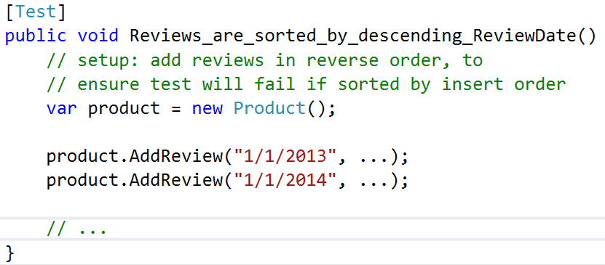
Good setup code is highly expressive
Comments are OK. Really.
Notes:
Example: Test asserts that product reviews are sorted in a specific way
Setup intentionally adds data in reverse order than it should be output
This arrangement is crucial – if we insert data in sorted order, how do we know the sorting code works?
Use comments to call attention to anything you do that isn’t immediately obvious
Different rules about comments in test code than production
Production code strives to make comments unnecessary – extract method
Less likely to extract small, one-off methods in test code
Multiple tests in single file – Extract Method clutters the files
Hard to manage at scale
We avoid comments in prod b/c they get stale when logic changes – setup code has lower rate of change than app code, less of a concern

Slide 38
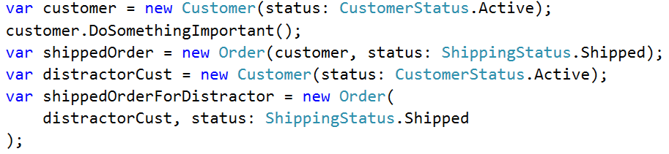
Good setup code is highly expressive
Comments are OK. Really.
Notes:
Another way that I use comments in tests is to organize setup code to make it easier to scan
In this example you can see that I’m creating a bunch of stuff,
it’s all packed together in one dense chunk
really hard to digest what’s actually happening
Transition: Any competent programmer could take time to study this code and figure it out, but the goal of expressive setup code is to make the test context as immediately digestible as possible

Slide 39
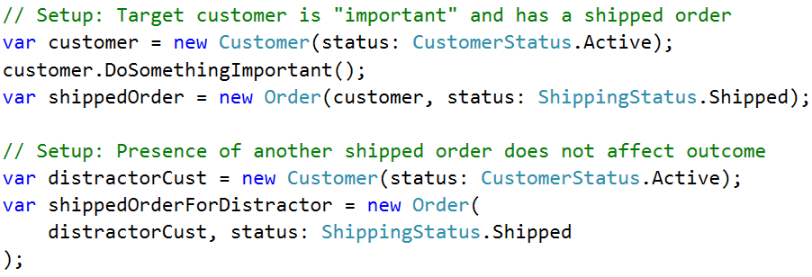
Good setup code is highly expressive
Comments are OK. Really.
Notes:
Notice how much easier it is to read when we use comments to break it up into logical sections.
Easily see that we’re creating a customer in one special state,
And another customer in a different state
Again, in production code I’d get rid of the comments and extract each block of code into a well-named method.
But in my test code, I find that this style works really really well.

Slide 40
Good setup code highlights significant data
Notes:
This next principle is that “good setup code highlights significant data”
Goal is to clearly identify the values or objects in the setup code that actually impact the test outcome
And clearly communicate HOW and WHY those values impact the test outcome
Easier for people to understand the context being created

Slide 41
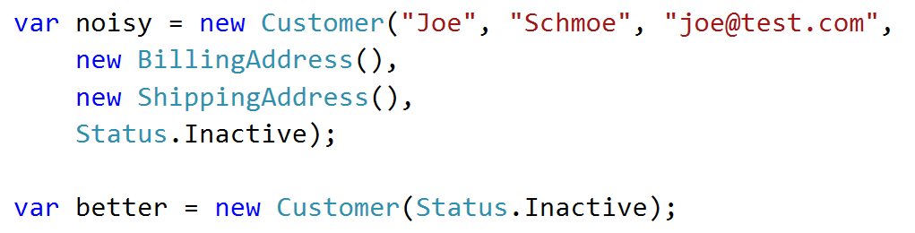
Good setup code highlights significant data
Only specify data that matter!
Notes:
The first way to do this is to remove from your setup code all of those intermediate objects and values that don’t impact the test outcome.
We saw this earlier when we talked about expressive code
We’ll see some patterns that make this easier in a little bit.

Slide 42
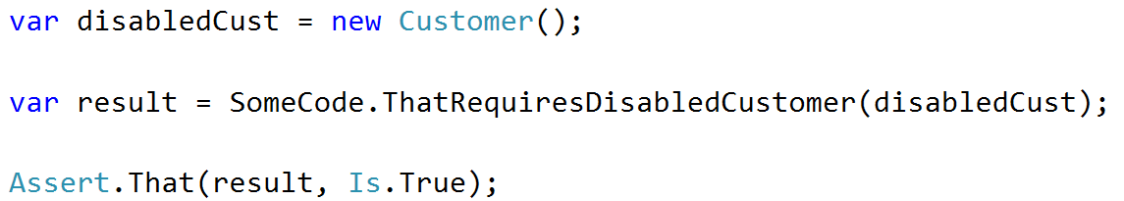
Good setup code highlights significant data
Significant data should be explicit, not implicit
Notes:
A corollary to the previous point is that all significant data should be explicitly set up by your test.
Don’t make assumptions or rely on implicitly created data
Hard to understand by someone that isn’t intimately familiar with those details
Hard to figure out if something changes and the test breaks,
In this example we are creating a customer object and we are relying on the fact that it’s default status is ACTIVE. If that default gets changed this test will start breaking and it could be hard to identify why.

Slide 43
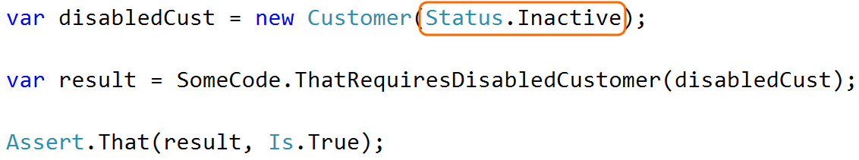
Good setup code highlights significant data
Significant data should be explicit, not implicit
Notes:
By being explicit in the setup code we more clearly capture our intent
Easier to comprehend
More resilient at the same time.

Slide 44
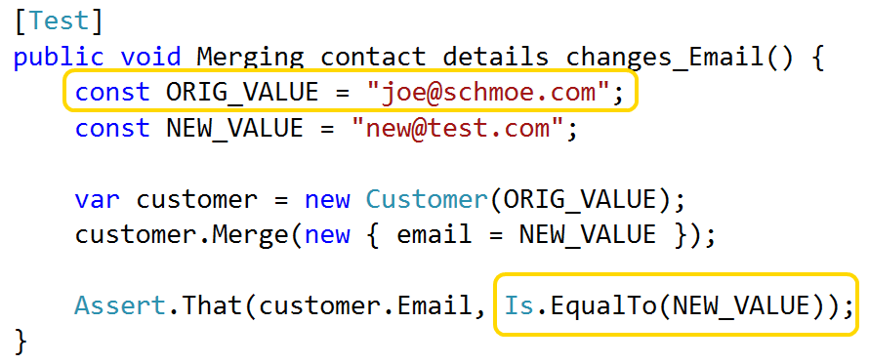
Good setup code highlights significant data
Named constants to communicate purpose
Notes:
Another way to improve expressiveness is by replacing key values with named constants
In this example, the actual value is irrelevant
Note how the names of “original value” and “new value” give extra clarity to the assertion
Pause
Transition: Of course, giving things good names applies everywhere, not just to constants.

Slide 45
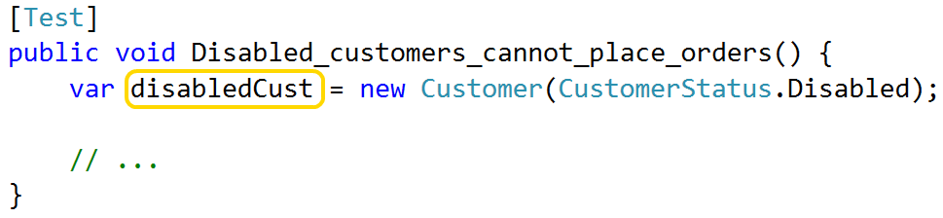
Good setup code highlights significant data
Give data objects descriptive names
Notes:
Just like in production code, give test objects names that communicate their purpose
If your test revolves around the fact that a Customer is disabled, call it “disabled customer”

Slide 46
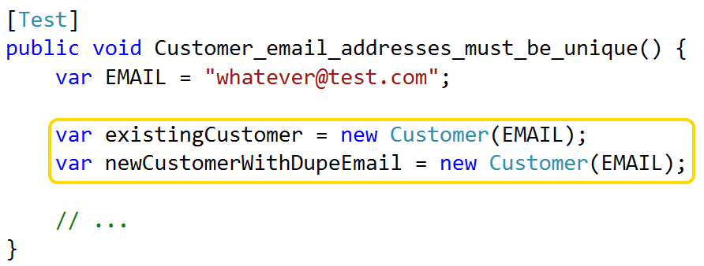
Good setup code highlights significant data
Give data objects descriptive names
Notes:
If contains multiple objects of same type, use names to differentiate them
Sounds obvious, but I’m still seeing smart, experienced programmers writing tests with “customer1” and “customer2”
Tests should tell a story – easier to understand when actors have meaningful names.

Slide 47
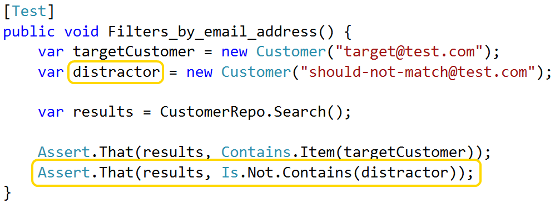
Good setup code highlights significant data
Consistent naming patterns = instant recognition
Notes:
The last suggestion I have for highlighting significant data is to use common naming patterns in your setup code.
EX: When writing tests for search or filter, important to do positive AND negative test
Just as important that code returns the things it should as does NOT return what it shouldn’t
My convention is to use the term “distractor” when naming the objects that shouldn’t get returned
Communicates object is not important, as long as its different from the target
Use that name consistently, co-workers immediately recognize the point of these objects
This sort of instant pattern recognition is a key benefit of expressive code

Slide 48
Good setup code is reusable
Avoid inheritance (for data reuse)
Hard to tweak data for each test
Can’t re-use in different base classes
Notes:
The third principle of good setup code is that it should be reusable.
Example:
Product, Order, Customer linked together
Useful when testing any of those objects
Don’t want to copy/paste
One common way to reuse setup logic is through inheritance. Don’t do that
Hard for each test to override and customize the data defined in a base class
We don’t want our Order tests and our Customer tests to share a base class, just so that they can share a little bit of data
Show examples in a bit of a pattern that’s purpose built for reusing setup logic

Slide 49
Good setup code is resilient
Trivial changes != mountains of errors
Notes:
4th principle of good setup code is that it is resilient to changes in the main app
Tests should be adding value
Not subtracting it by demanding constant attention

Slide 50
Good setup code is resilient
Trivial changes != mountains of errors
Minimal effort to refactor tests
Notes:
In the same vein, we want to be able to easily refactor our test projects
Seen people be sloppier in test code than real code – that’s a mistake
Important to keep tests malleable

Slide 51
Recap: Principles of good test setup code
Highly expressive
Highlights data that impact the test outcome
Is reusable (without inheritance)
Resilient / easy to maintain
Notes:
Just identified 4 principles of good setup code.
Next - concrete patterns and practices for adhering to these principles

Slide 52

Patterns & Practices - show me the codez!
Notes:
Most important thing to improve setup code – stop constructing test objects by hand
Push into helper for two benefits:
Shorter setup code - easier to write and maintain
Greater resiliency - if an object changes, only modify helper

Slide 53
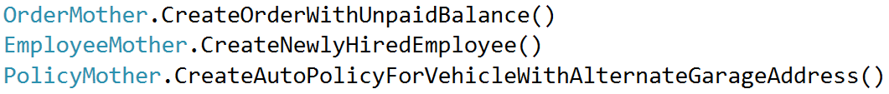
Patterns we tried, but didn’t like
Object Mother
Notes:
We tried a couple existing object creation patterns but had some problems with them
First pattern we tried was called Object Mother
Refers to a factory that returns fully-constructed objects in a very specific state
Examples
Object Mother does good of making your tests more expressive, but it doesn’t scale well
As software grows = more and more pre-built objects
As the number of pre-built objects grows = harder to maintain them and choose
TRANSITION: Over time, as your software grows and developers need to handle new setup needs, you end up with a mess like this:

Slide 54
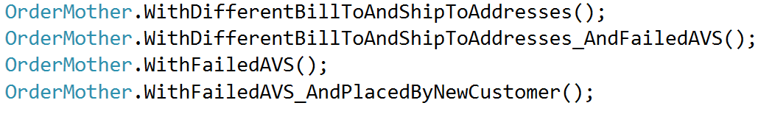
Patterns we tried, but didn’t like
Object Mother
Notes:
As you can see
lots of overlap between these methods,
the more methods that exist the harder it is to choose between them.
What happens if someone needs an order that:
Is placed by a new customer,
AND failed AVS
AND has different bill-to and ship-to addresses?
They’d probably add yet another factory method and contribute to the bloat.
Transition: My main problem with Object Mother is that it requires that all significant object states be created up front. In my software, however, there are tons of significant states and I really want the ability to more precisely control my test data in each test.

Slide 55
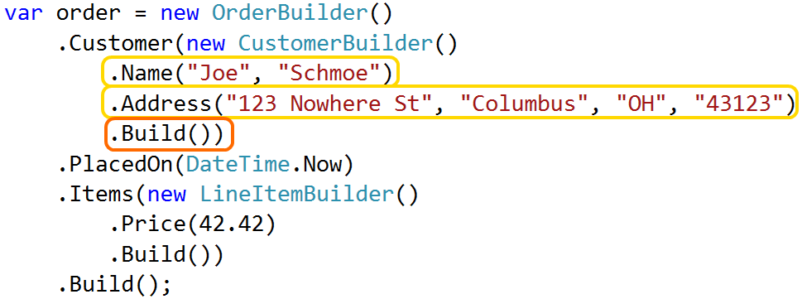
Patterns we tried, but didn’t like
Data Builder
Notes:
The next thing we tried was a pattern called Data Builder.
Rather than pre-built objects, Data Builder lets you create customized objects in the body of each test
Builder uses a Fluent API to expose methods for customizing the object in different ways
You chain these methods together and call Build() at the end, at which point the Builder returns a fully constructed object
I like this approach a lot more than Object Mother because it makes it easy to create the precise data we need for each test. Rather than picking from a library of pre-built data I can easily construct exactly what I need. In general, this scales better than Object Mother.

Slide 56
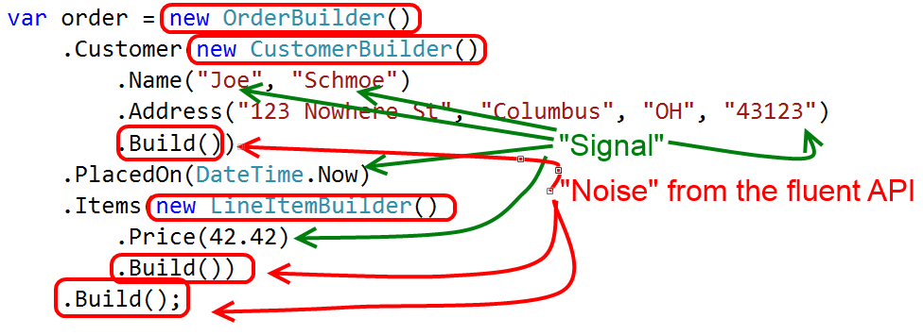
Patterns we tried, but didn’t like
Data Builder
Notes:
However, I’m really not a big fan of the Fluent API because it’s very verbose.
Green arrows point to the significant data that I’m creating
Red circles are the “noise” that we get from the fluent API.
In addition, actually implementing the fluent API is tedious.
Lot of boilerplate code that, in my experience, isn’t worth the effort.
I haven’t been very happy with the results of using this pattern in any large scale.
Transition: After some experimentation, we decided that we wanted something that was concise like Object Mother but flexible like Data Builder. We eventually created a hybrid pattern that takes the best aspects of each.
We have internally referred to this pattern as “Test Helper”. I admit that’s a pretty lame and generic name, we just never took the time to find something better.
Rather than dwell on the name, however, I want to focus on the details of the pattern itself.

Slide 57
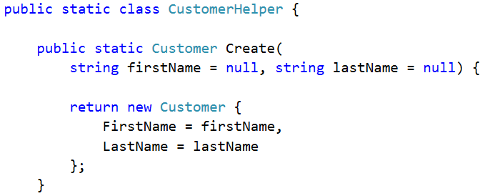
Patterns & Practices – Test Helpers
Like Object Mother, but customizable
Like Data Builder, without the fluent API
Notes:
Basically, a “Test Helper” combines the static factory class of Object Mother with the customizable nature of a Data Builder.
Static classes that expose SMALL number of GENERIC factory methods.
Customized via method args
I start by creating a static class, one for each type of object that I’ll create. By convention I name these like “FooHelper”
I then create a static method called Create and I expose each customizable property as a method parameter.
Remember – callers should only specify values that impact test outcome
Make params optional by assigning a default value in method signature

Slide 58
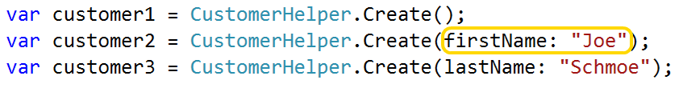
Patterns & Practices – Test Helpers
Like Object Mother, but customizable
Like Data Builder, without the fluent API
Notes:
When you call the method, use this “named argument” syntax to pick & choose arguments to specify
Any optional parameter that you don’t provide is assigned its default value
Clean, low-noise API for describing test data in precise detail
Transition:
In order for this pattern to work really well there are a couple of things to keep in mind as you design your helpers.

Slide 59
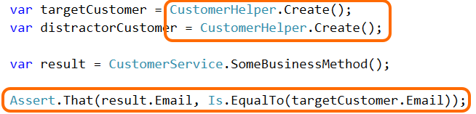
Patterns & Practices – Test Helpers
Assign unique values – avoid “unexpected equality”
Notes:
First, avoid setting properties to null or hardcoded values because this leads to “unexpected equality”
For example, let’s say you create two different Customers from the helper, one called “target” and one called “distractor”. You then do whatever you’re trying to test, and finally you make an assertion that your method under test returned a result that’s equal to the target customer’s email.
The assumption here is that the test will fail if the code returns the distractor’s email address. But if the CustomerHelper object sets a default email address of NULL, or some hardcoded static value, then this test will pass even if the logic is faulty because both objects were created with the same value. This is what I mean by “unexpected equality”.

Slide 60
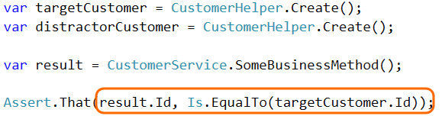
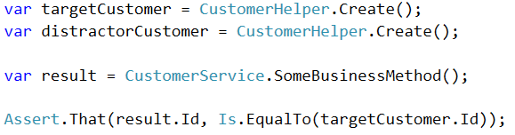
Patterns & Practices – Test Helpers
Assign unique values – avoid “unexpected equality”
Notes:
This issue of “unexpected equality” also applies when you’re dealing with Entity IDs
In an integration test, where you’re loading data from an actual database, you know that every object will have a unique ID
In a unit test, where we’re dealing with in-memory objects only, we don’t have that guarantee
Nothing prevents you from creating multiple customers all with the ID of 0 or some other value
To avoid this issue of “unexpected equality”, MAKE VALUES UNIQUE BY DEFAULT – force callers to be explicit if they want things to be equal

Slide 61
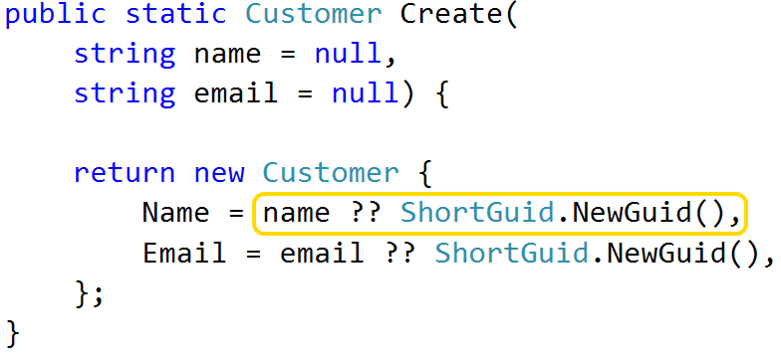
Patterns & Practices – Test Helpers
Assign unique values – avoid “unexpected equality”
ShortGuid for short, unique strings (bit.ly/1dCxSbe)
Notes:
Nice way of creating unique strings is w/ ShortGuid
Compresses a normal GUID into a 22-character string by Base64-encoding it
Result is short, URL-friendly, and unique
In this example, every string property on the Customer will be unique unless caller specifies a value

Slide 62
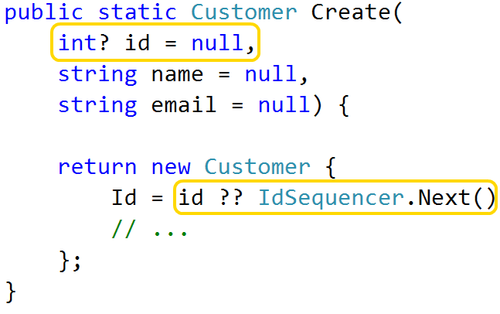
Patterns & Practices – Test Helpers
Assign unique values – avoid “unexpected equality”
ShortGuid for short, unique strings (bit.ly/1dCxSbe)
IdSequencer for unique integers (bit.ly/1d7zHz7)
Notes:
To create unique integers, I use a class I call the IdSequencer which you can get from my GitHub
Every time you call Next() it returns a new value and it keeps track of the values it’s handed out
This makes it really easy to guarantee that every in-memory object that you create with a helper will have a unique ID, unless the caller has explicitly provided a value to use

Slide 63
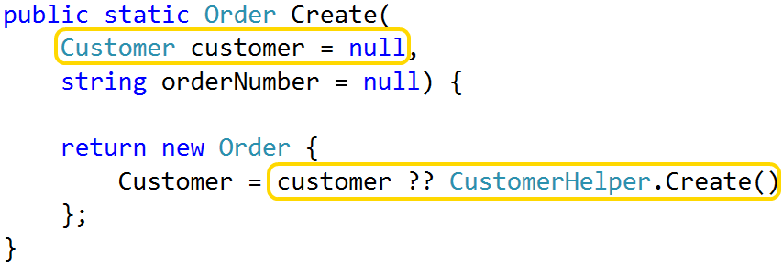
Patterns & Practices – Test Helpers
Delegate to other helpers as needed
Notes:
It’s also important that each Test Helper is concerned with creating a single type of object only
If your object has dependency, delegate to another helper to create it
Here’s an example of an Order Helper that allows its Customer to be passed as a parameter
If the caller doesn’t pass a Customer, it calls the CustomerHelper
This way we end up with a fully-specified object, and each helper stays focused on one thing only

Slide 64
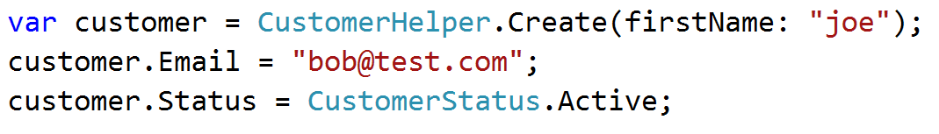
Patterns & Practices – Test Helpers
Avoid modifying test data outside of a helper
Notes:
Sometimes you’re going to need to customize an object in a way the helper wasn’t built to support
Maybe you need to modify some properties that weren’t exposed as customizable
Maybe you need to do something more complex than setting a few properties
You might be tempted to call the helper, do what you can, and then further modify the object that gets returned
AVOID this if you can
Harder to understand – reader has to comprehend helper call AND tweaks
Hard to maintain – the test makes assumptions about what gets returned;
Test should depend ONLY on data it specifies itself.
It isn’t always possible to avoid, but always try to extend the helper before you do anything in a one-off test

Slide 65
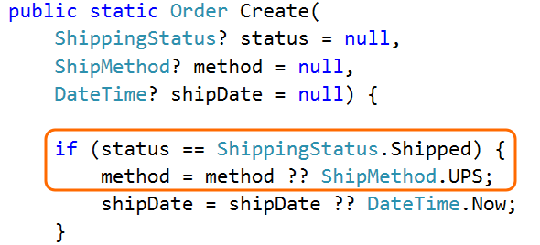
Patterns & Practices – Test Helpers
Can act like an Object Mother, too
Notes:
Generally speaking, helpers have a single generic factory method called Create()
Whole point is that caller specifies what it cares about
Sometimes you’ll start to see logic develop inside that generic method
For example:
Let’s say that you have an e-commerce app and you often need to create a Shipped order in your tests
Let’s also assume that one business rule is that you can’t set the status to Shipped without also specifying a ShippingMethod and ShippedDate
However, if the shipping method and date don’t matter to the test, we don’t want to specify them in our tests
One way to handle this is to write logic that conditionally sets default values. For instance, we can set different defaults for ShippingMethod and ShippedDate based on whether or not the caller told us the order was SHIPPED.
This works well, but it has two drawbacks:
1) If you have a complicated domain then your helpers can sometimes get a bit messy or complicated when you do it this way
2) There’s no easy way to search your test code for all places that are creating a Shipped order
CLICK: Another way to handle this is to create a new factory method very similar to Object Mother

Slide 66
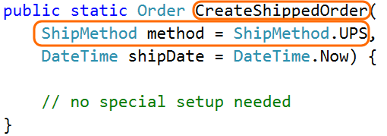
Patterns & Practices – Test Helpers
Can act like an Object Mother, too
Notes:
In this case I’ve created a factory method that is purpose built for creating shipped orders.
By doing that, I no longer need to expose the shipping status as a parameter, and I no longer need the shipping method and ship date to default to null.
We know that in order to call this method we have to have a ship method and date, so I can specify those defaults directly in the argument declaration.
As a result, the body of the helper is much simplified.
Transition: My advice is to do this sparingly because it has the same drawbacks as the Object Mother pattern. If you’re not careful, you’ll end up with a ton of overlapping methods to choose from. I tend to have a small number of factory methods for very common and coarse grained specification, and then rely on parameters to specialize the data further.

Slide 67
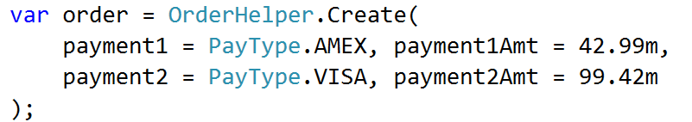
Patterns & Practices – Test Helpers
API should be declarative – describe the “what”, not the “how”
Notes:
Another key point to keep in mind is that the API exposed by your helpers should be declarative in nature.
As much as possible, describe what is being created and not how it’s being created.
In this example I show a helper that can create an order with multiple payment types
This could be modeled lots of different ways in the application. Maybe the Order object has a collection of Payment objects that need to be inserted, or maybe the Order exposes properties called “Payment1” and “Payment2” and so on
You can abstract those details away from your setup code by doing something like this
Let the helper worry about how to build the domain object from those parameters; keep the tests themselves clean and expressive

Slide 68
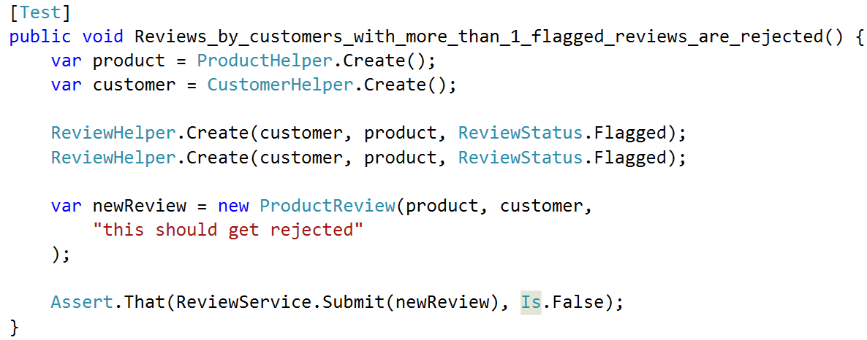
Patterns & Practices – Scenarios
Notes:
Test Helpers are great at returning single object - track of multiple objects AND their relationships?
Example: product review feature
Create a product
Create a customer
Create objectionable reviews linking them together
Assert that new reviews are rejected
Not a bad test, but could be better
Wiring up by hand is tedious & sacrifices expressiveness
Copy/paste reuse

Slide 69
Patterns & Practices – Scenarios
A façade for invoking multiple Test Helpers
Use when objects have relationships you care about
Notes:
In these situations we use a pattern we call a “Scenario”
Essentially a façade that simplifies the usage of multiple Test Helpers towards a common goal
Provides a convenient way of tracking relationships between test data

Slide 70
Patterns & Practices – Scenarios
A façade for invoking multiple Test Helpers
Use when objects have relationships you care about
Reuse complex arrangements w/out inheritance
Notes:
Scenarios are specifically designed for reuse
Transition: So what does a Scenario object look like?

Slide 71
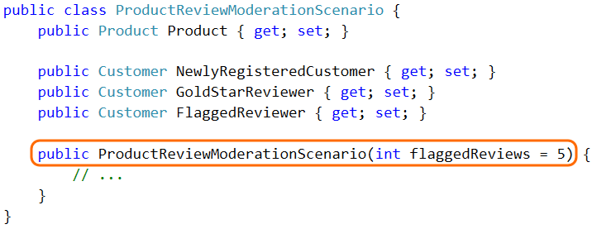
Patterns & Practices – Scenarios
Scenarios get instantiated
Notes:
Biggest difference between Scenario & Test Helper – static factory vs instance
The scenario is customized by passing in constructor arguments

Slide 72
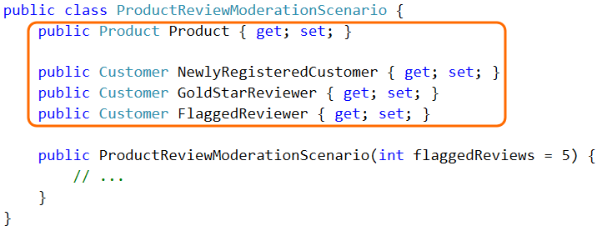
Patterns & Practices – Scenarios
Expose key data as instance properties
Notes:
After you instantiate it, the Scenario exposes its key data as instance properties.
In this case, the scenario contains a Product and three different types of Reviewers
Properties should be well-named and, if complex enough, commented

Slide 73
Patterns & Practices – Scenarios
Which is more expressive?
Notes:
Here’s that example again of the Product Review test that is NOT using a Scenario
Certainly not a terrible test - could be better
TRANSITION: Look what happens when we re-write it using a scenario

Slide 74
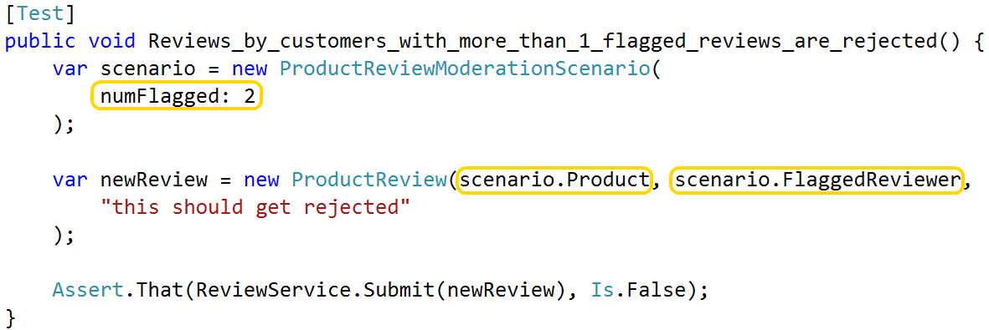
Patterns & Practices – Scenarios
Which is more expressive?
Notes:
Replaced the explicit creation of two flagged reviews with a single declarative argument
Notice how much less noisy it is, without the customer and product objects
To repeat this test with a different # of flagged reviews, copy 1 line of code & change 1 argument
Excellent example of how expressive setup code makes it easy to add new tests

Slide 75
Patterns & Practices – Scenarios
Same drawbacks as Object Mother
Painful when tests need to customize data
Hard to change once many tests use it
Notes:
Not perfect
Same drawbacks as Object Mother – Scenario is basically a Mother for a group of objects

Slide 76
Patterns & Practices – Scenarios
Same drawbacks as Object Mother
Painful when tests need to customize data
Hard to change once many tests use it
Rarely reusable globally
Scenarios represent tight coupling between data
Notes:
Mitigated somewhat by the fact that Scenarios are rarely reusable in any broad terms
By their nature, represent tight coupling between multiple objects
Coupling reduces their ability to be reused in different contexts

Slide 77
Patterns & Practices – Scenarios
Same drawbacks as Object Mother
Painful when tests need to customize data
Hard to change once many tests use it
Rarely reusable globally
Scenarios represent tight coupling between data
Use when…
Related tests share complex setup
Core set of objects must be created; don’t impact outcomes
Notes:
I use Scenarios when a group of related tests share complex setup & core objects don’t impact outcomes
I rarely use them in a wider context

Slide 78
Advanced Techniques – integration tests
Notes:
Until now, in-memory objects only
Eventually, you’re going to want to save your test data to a database so that you can test your data access code, or so that you can automate some of your full-stack system tests.
In this final section, I’ll show you some advanced tips for making your integration tests as easy to set up as possible

Slide 79
Advanced Techniques – integration tests
Goal: same patterns to create in-memory and in-db data
Notes:
Goal is to use the same Test Helpers to create real data as in-memory data

Slide 80
Advanced Techniques – integration tests
Goal: same patterns to create in-memory and in-db data
Challenges:
Foreign keys
Column constraints
Don’t litter database with junk data
Notes:
Easier said than done.
First, you have to deal with foreign keys.
Can’t just new up a Customer and an Order in-memory & then save them
Have to new up entire object graph, save objects to the database in the correct sequence, and then update all the IDs
(This is a little bit easier if you assign primary keys in your application code, but my project uses good old-fashioned autonumber keys)
Second, you have to deal with column constraints.
Non-null columns
Max length
* Lastly, clean up test data when the test run is over.

Slide 81
Advanced Techniques – integration tests
Goal: same patterns to create in-memory and in-db data
Challenges:
Foreign keys
Column constraints
Don’t litter database with junk data
Solution: Add a Save() method to Test Helpers
Notes:
These challenges are a pain, but they are manageable with a few extra additions to your Test Helper classes.
The solution we use is to add a Save() method to your Test Helpers
Before I show you how that works, I want to mention a few things
First, this feature assumes you’re using an ORM of some sort. If you’re NOT using an ORM then the concept still applies, but you’ll need to find a different implementation
Second, these code samples are for Nhibernate. You’ll obviously need to modify them to work with Entity Framework or Active Record or whatever you’re using
Let’s look at how the Save method is implemented in my helpers

Slide 82
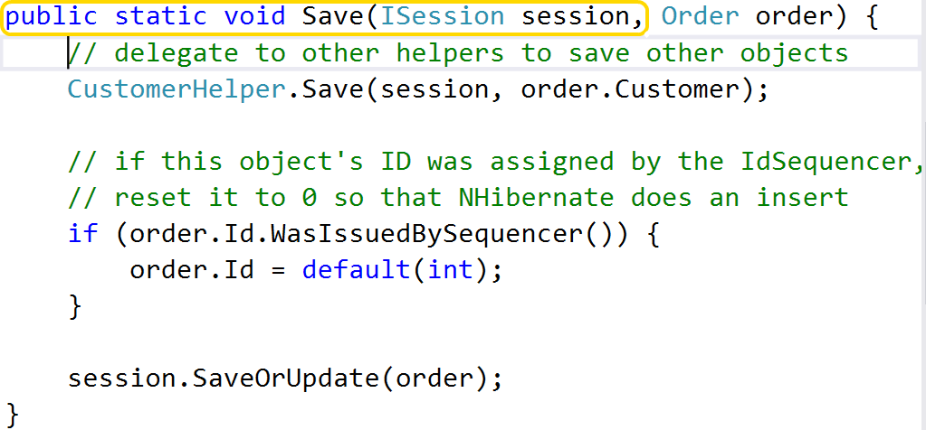
Advanced Techniques – integration tests
Notes:
1st, Save() is static & takes ORM interface as an argument.
It’s certainly possible to use Dependency Injection
All the other helper methods are static – not worth effort for my team

Slide 83

Advanced Techniques – integration tests
Notes:
Next, note that we delegate to other helpers to save any of our dependent objects
Can’t save an Order unless it refers to a valid customer – save the Customer first
Remember, each Test Helper deals w/ one object type only

Slide 84

Advanced Techniques – integration tests
Notes:
Third, Save method is responsible for resetting any Id values that were assigned by the IdSequencer to 0
We’re using Nhibernate in this example, and if we tell it to save an object that has a non-zero ID, it will issue an update
If the object is something new, resetting the Id to zero forces it to do an insert, which is what we want
Note that we don’t need to reset ALL values that were assigned by the IdSequencer, only entity IDs

Slide 85

Advanced Techniques – integration tests
Notes:
Finally, we delegate to the ORM to insert or update the object
Each helper should know how to save the objects that it creates
The implementation of your Save methods will be driven by your Create methods –
Does NOT need to handle any arbitrary object, only those configurations created by the helper
Transition
Finally, we need to prevent this test data from lingering around when our test run is over
One possibility is to reset the database to a known state at the start of each test run. This works, but I tend to run my unit tests against the same DB I use for local testing
Don’t want data I’ve crafted by hand from being blown away by tests
Don’t want to lose any schema changes I’ve made

Slide 86

Advanced Techniques – integration tests
[Rollback] attribute
Creates DB transaction when test starts
Rolls back when test ends
Notes:
Another option is to wrap each test run in a database transaction, and then roll back that transaction when the test run is over
This is easy to do by adding an attribute to our data tests. The presence of this attribute automatically executes the test inside of a transaction, and then discards the transaction at the end.

Slide 87
Order brought to chaos
Notes:
Here’s that nasty chunk of setup code I showed at the start

Slide 90

Order brought to chaos
Notes:
Here’s that same chunk of code, cleaned up and using Helpers
Determined many objects were irrelevant – pushed into helpers & used defaults
Still creating a lot of objects, but something that’s manageable
Said it before and I’ll say it again; single most important thing you can do to improve your test setup is to build a good helper library.

Slide 91
Land of milk, honey, and unicorns
Clean, expressive, resilient
Notes:
Let’s recap and talk about how you’re going to make a difference in your tests.
First, remember the principles of good setup code: it’s clean, expressive and resilient.
Strive to make your intent as clearly evident as possible. Make it easy for people to understand your test setup, and keep your maintenance costs in check.

Slide 92
Land of milk, honey, and unicorns
Clean, expressive, resilient
Test helpers + defaults
Notes:
How do we do that? Stop creating data by hand! Create a library of test helpers to do it for you.
Also, when you’re creating objects using those helpers, only specify the values that impact the test outcome; use defaults for everything else.
If you use a literal value in your test setup, it should be significant.

Slide 93
Land of milk, honey, and unicorns
Clean, expressive, resilient
Test helpers + defaults
Hard to test == too complex. Simplify!
Notes:
Third: if something is hard to test, or it’s hard to write a test helper for something, then it’s probably too complex.
Don’t spend a lot of effort fighting with the tests or the test helper, simplify your application design instead.
And whatever you do, don’t be “clever” in your setup code! Keep it clean and simple; Remember that today’s clever is tomorrow’s throat punch from a co-worker!

Slide 94
Land of milk, honey, and unicorns
Clean, expressive, resilient
Test helpers + defaults
Hard to test == too complex. Simplify!
Use on ALL projects – old, big, new, small
Notes:
Finally, I recommend that you consider these techniques for ALL of your projects.
Small and simple
May not have the problems these techniques are designed to address
Software rarely stays small and simple over time
The cheapest time to introduce these patterns is when things are small and simple; dividends over time
Adding these helpers to a large existing project is more painful.
I’ve been there, done that, and it is absolutely worth the effort.
The sooner that you introduce these patterns, the sooner they will start giving benefits
It may take a little while until you start picking up momentum from them, but you WILL get there if you stay the course

Slide 95
Notes:
About an hour ago I made the assertion that your tests suck. I said that they suck up your time, energy and money and leave you frustrated. I promised to lead you out of that place of darkness and into the land of milk, honey and unicorns where testing is fun and tests are easy to write, easy to read, and easy to maintain.
My new assertion is that your tests aren’t going to suck any longer. I’ve shown you the things to stop doing and the things to do instead. I have given you benefits of over six years of testing complex systems. I have given you everything that you need to keep this assertion green.
I have brought you to the threshold of the promised land. Whether you take up residence here, or whether you go back to that land of frustration and darkness and confusion, is up to you. Choose wisely.
THANK YOU!

Slide 96
That’s all, folks!
Materials
github.com/spetryjohnson
www.petry-johnson.com
Contact
@spetryjohnson
seth@petry-johnson.com
Notes:
You can find these slides on my GitHub account, and if you have any questions or other feedback you can reach me on Twitter or email.
THANK YOU!

